Slide 1
FAQ:
Q. How do I reset the links on the main board back to yellow?
A. Simply close the PowerPoint file, and re-open, and the links will turn back to yellow.
Q. Can I use this in Keynote / Google Slides / Open Office?
A. Sorry, but Google slides, Keynote, Open Office etc. are not supported. Those are great programs but they’re not made to handle a file with this animation complexity.
Q. Why aren’t the sound effects working?
A. If the sound effects aren’t working, I would suggest upgrading your PowerPoint to something newer than 2008, and using a PC instead of a Mac if possible. Also, Google slides, Keynotes, etc. are not supported.
Q. Can I get a board with less categories? Can I add a custom logo?
A. Unfortunately these changes are a little too complex for me to explain or assist you via email, but if you’d like me to do a custom job for you for a small fee, send me an email at Reid@youthdownloads.com. You can also try using an App I made called TriviaMaker which lets you easily create Jeopardy style games and customize the number of categories, colors and logo at www.TriviaMaker.com
Q. Is there a tutorial I can watch to edit / play this game?
A. Yes. To see it in action, or learn how to make edits, watch this video: https://youtu.be/tDC1mXh9NPE
Notes:
Family Feud Template
Introduction Slide – Family Feud!

Slide 2
JEOPARODY JEOPARODY JEOPARODY JEOPARODY JEOPARODY JEOPARODY JEOPARODY JEOPARODY JEOPARODY JEOPARODY JEOPARODY JEOPARODY JEOPARODY JEOPARODY JEOPARODY JEOPARODY JEOPARODY JEOPARODY JEOPARODY
JEOPARODY JEOPARODY JEOPARODY JEOPARODY JEOPARODY JEOPARODY JEOPARODY JEOPARODY JEOPARODY JEOPARODY JEOPARODY JEOPARODY JEOPARODY JEOPARODY JEOPARODY JEOPARODY JEOPARODY JEOPARODY JEOPARODY

Slide 3
HERE ARE TODAY’S CATEGORIES

Slide 4
Picture

Slide 5
Synonyms

Slide 6
Antonyms

Slide 7
Fill in the Blank

Slide 8
In Your Own Words

Slide 9
Definitions

Slide 10
Picture
Synoyms
Antonyms
Fill in the Blank
In Your Own Words
Definitions
$100
$100
$100
$100
$100
$100
$200
$200
$200
$200
$200
$200
$300
$300
$300
$300
$300
$300
$400
$400
$400
$400
$400
$400
$500
$500
$500
$500
$500
$500
FINAL JEOPARODY

Slide 11
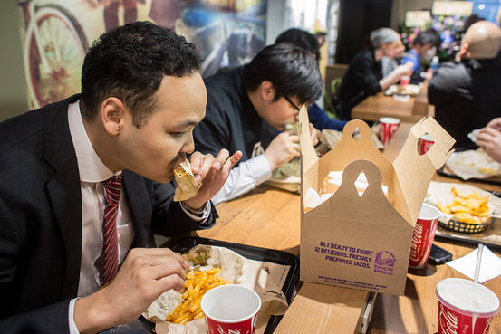
Notes:
Picture 100

Slide 12
patron

Slide 14
repertory

Slide 16
resonant

Slide 17
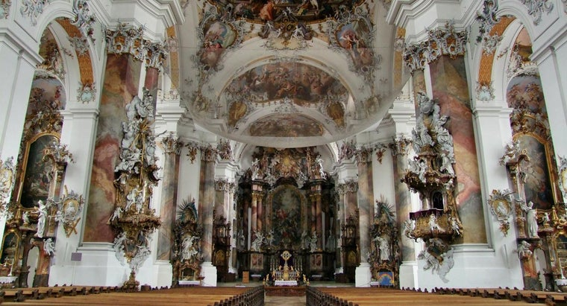

Slide 18
rococo

Slide 19
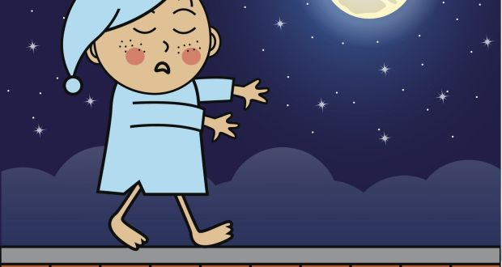
Notes:
Picture 500

Slide 20
somnambulist
Notes:
Picture 500 answer

Slide 21
Low, deep
Notes:
Synomyms 100 question

Slide 22
resonant

Slide 23
A customer of a store or restaurant

Slide 24
patron

Slide 25
A collection of stories

Slide 26
repertory

Slide 27
Fancy, ornate

Slide 28
rococo

Slide 29
post

Slide 30
stake
Notes:
500 synonyms answer

Slide 31
boycott
Notes:
Antonym 100

Slide 32
patron
Notes:
Antonym 100 answer

Slide 33
Faint, weak

Slide 34
resonant

Slide 35
plain

Slide 36
rococo

Slide 37
Sleep paralysis

Slide 38
somnambulist

Slide 39
Beam, stick, log
Notes:
Antonmym 500 question

Slide 40
stake
Notes:
Antonym 500 answer

Slide 41
He is a ____ of Taco Bell.
Notes:
Fill in blank 100 taco bell

Slide 42
patron

Slide 43
The theater has a _________ of plays.

Slide 44
Repertory

Slide 45
He has a deep _________ voice.

Slide 46
resonant

Slide 47
The theater had ________ ceilings.

Slide 48
rococo

Slide 49
Sometimes he is a ________ at night.

Slide 50
somnambulist

Slide 51
Elaborate style of decoration
Notes:
In your own words 100

Slide 52
rococo

Slide 53
Walking while you are sleeping

Slide 54
somnambulist

Slide 55
Collection of stories

Slide 56
repertory

Slide 57
Deep clear sound

Slide 58
resonant

Slide 59
A strong wooden or metal post driven into the ground

Slide 60
stake

Slide 61
sleepwalker

Slide 62
somnambulist

Slide 63
Having excessive asymmetrical ornamentation

Slide 64
rococo

Slide 65
Characterized by a loud deep sound

Slide 66
resonant

Slide 67
Story; stock, repertoire

Slide 68
repertory

Slide 69
One who give support(usually financial)

Slide 70
patron

Slide 72
Choose one of our previous words and define it.
GO TO
PROMPT
(RESPONSE)
Start Timer

Slide 73
Answers will vary!

