Slide 1
FAQ:
Q. How do I reset the links on the main board back to yellow?
A. Simply close the PowerPoint file, and re-open, and the links will turn back to yellow.
Q. Can I use this in Keynote / Google Slides / Open Office?
A. Sorry, but Google slides, Keynote, Open Office etc. are not supported. Those are great programs but they’re not made to handle a file with this animation complexity.
Q. Why aren’t the sound effects working?
A. If the sound effects aren’t working, I would suggest upgrading your PowerPoint to something newer than 2008, and using a PC instead of a Mac if possible. Also, Google slides, Keynotes, etc. are not supported.
Q. Can I get a board with less categories? Can I add a custom logo?
A. Unfortunately these changes are a little too complex for me to explain or assist you via email, but if you’d like me to do a custom job for you for a small fee, send me an email at Reid@youthdownloads.com. You can also try using an App I made called TriviaMaker which lets you easily create Jeopardy style games and customize the number of categories, colors and logo at www.TriviaMaker.com
Q. Is there a tutorial I can watch to edit / play this game?
A. Yes. To see it in action, or learn how to make edits, watch this video: https://youtu.be/tDC1mXh9NPE
Notes:
Family Feud Template
Introduction Slide – Family Feud!

Slide 2
JEOPARODY JEOPARODY JEOPARODY JEOPARODY JEOPARODY JEOPARODY JEOPARODY JEOPARODY JEOPARODY JEOPARODY JEOPARODY JEOPARODY JEOPARODY JEOPARODY JEOPARODY JEOPARODY JEOPARODY JEOPARODY JEOPARODY
JEOPARODY JEOPARODY JEOPARODY JEOPARODY JEOPARODY JEOPARODY JEOPARODY JEOPARODY JEOPARODY JEOPARODY JEOPARODY JEOPARODY JEOPARODY JEOPARODY JEOPARODY JEOPARODY JEOPARODY JEOPARODY JEOPARODY

Slide 3
HERE ARE TODAY’S CATEGORIES

Slide 4
Picture

Slide 5
Synonyms

Slide 6
Antonyms

Slide 7
Fill in the Blank

Slide 8
In Your Own Words

Slide 9
Definitions

Slide 10
Picture
Synoyms
Antonyms
Fill in the Blank
In Your Own Words
Definitions
$100
$100
$100
$100
$100
$100
$200
$200
$200
$200
$200
$200
$300
$300
$300
$300
$300
$300
$400
$400
$400
$400
$400
$400
$500
$500
$500
$500
$500
$500
FINAL JEOPARODY

Slide 11
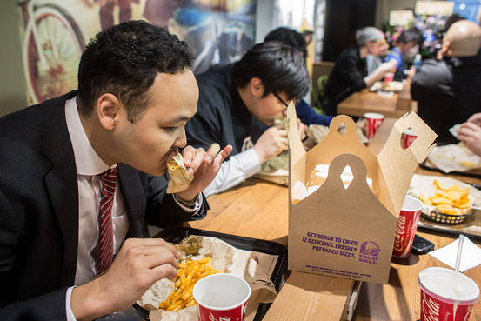
Notes:
Picture 100

Slide 12
patron

Slide 14
repertory

Slide 15
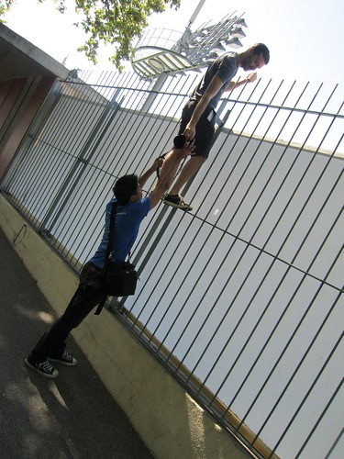
Notes:
abet

Slide 16
abet

Slide 17
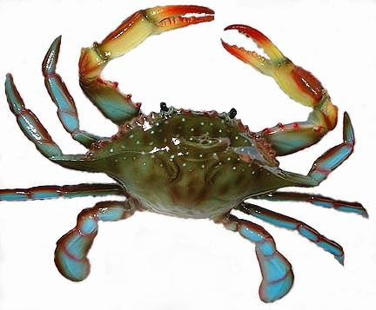
Notes:
crabbed

Slide 18
crabbed

Slide 19
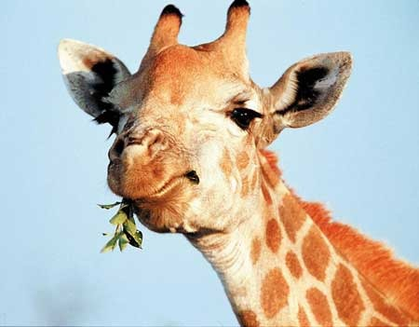
Notes:
Picture 500 masticate

Slide 20
masticate
Notes:
Picture 500 answer masticate

Slide 21
Low, deep sound
Notes:
Synomyms 100 question

Slide 22
resonant

Slide 23
To help someone

Slide 24
advocate

Slide 25
Personality qualities/traits

Slide 26
disoposition

Slide 27
Someone who does not like war

Slide 28
pacifist

Slide 29
Walking while sleeping

Slide 30
somnambulist
Notes:
500 synonyms answer

Slide 31
Poor needy
Notes:
Antonym 100

Slide 32
affuluence
Notes:
Antonym 100 answer

Slide 33
Simple, easy, plain

Slide 34
intricate

Slide 35
Ignore, avoid looking at

Slide 36
ogle

Slide 37
Living thing

Slide 38
Carrion

Slide 39
Poor, not wealthy
Notes:
Antonmym 500 question

Slide 40
blighted
Notes:
Antonym 500 answer

Slide 41
She likes to _____ her teachers.
Notes:
Fill in blank 100 taco bell

Slide 42
besiege

Slide 43
The dog has a friendly________.

Slide 44
Disposition

Slide 45
Don’t _____ on your bad grades from last year.

Slide 46
dwell

Slide 47
The surgeon used a _____ during surgery.

Slide 48
lancet

Slide 49
Read the _____ carefully before answering the questions.

Slide 50
passage

Slide 51
Get away from
Notes:
In your own words 100

Slide 52
elude

Slide 53
Something you can’t change

Slide 54
irrevocable

Slide 55
Proud to be part of one political party

Slide 56
partison

Slide 57
Elaborate style of decoration

Slide 58
rococo

Slide 59
A strong wooden or metal post driven into the ground

Slide 60
stake

Slide 61
sleepwalker

Slide 62
somnambulist

Slide 63
Having excessive asymmetrical ornamentation

Slide 64
rococo

Slide 65
Characterized by a loud deep sound

Slide 66
resonant

Slide 67
Story; stock, repertoire

Slide 68
repertory

Slide 69
One who give support(usually financial)

Slide 70
patron

Slide 72
Affected by something that prevents growth or prosperity
GO TO
PROMPT
(RESPONSE)
Start Timer

Slide 73
What is blighted?

